Slide 1
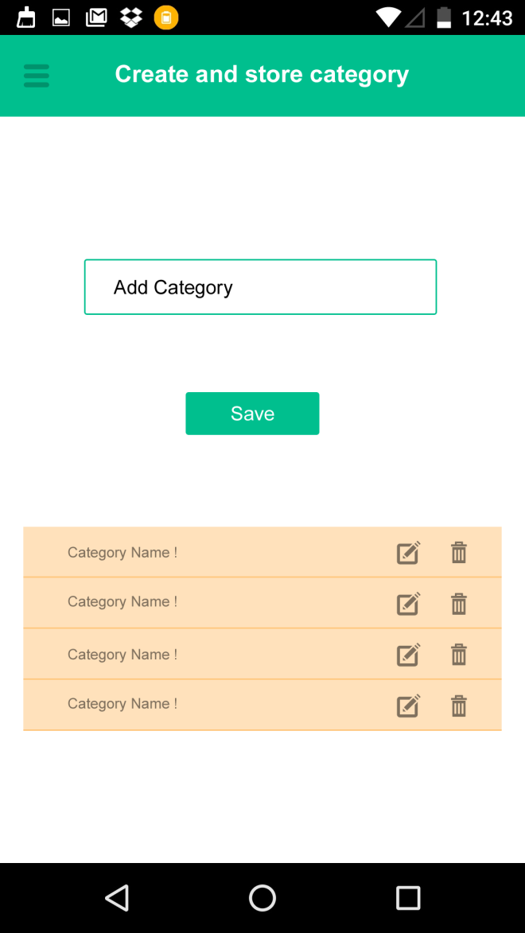
Below technologies needs to be done in practical.
1)MVVM
2) ROOM
3) DATA Binding
4) Constraint layout
You need to save category in Room database. Need to create separate table for category.
Also you need to displayed already saved Category from db.
User can also edit/Delete the same.

Slide 2
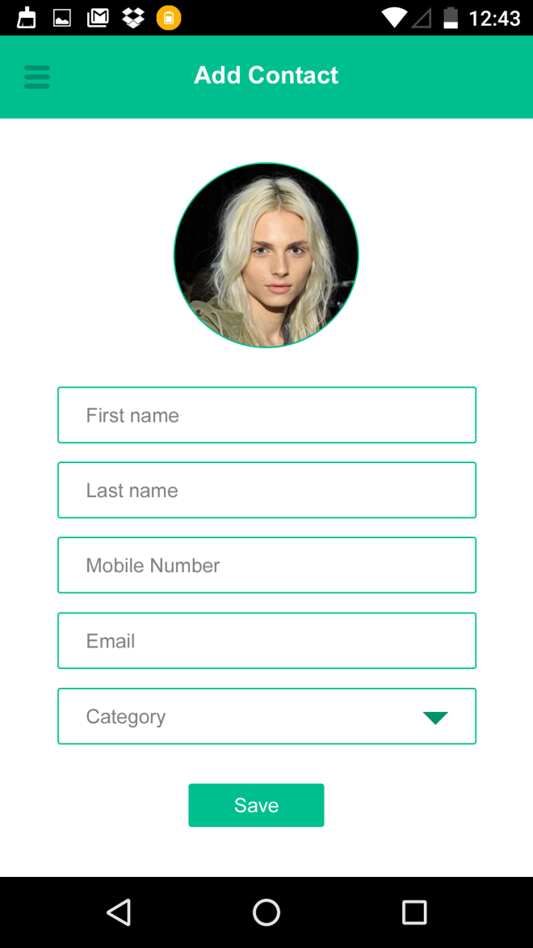
User can create a contact by filling details shown in the forms.
User can choose profile image from Gallery. As an add-on feature you can add image from camera.
Category dropdown will be filled from category table added in first screen.
All fields are mandatory and appropriate validation should be applied.
On Click of Save button need to add all the fields in Contact table in database. As on add-on you can also add same contact in device’s native contact.

Slide 3
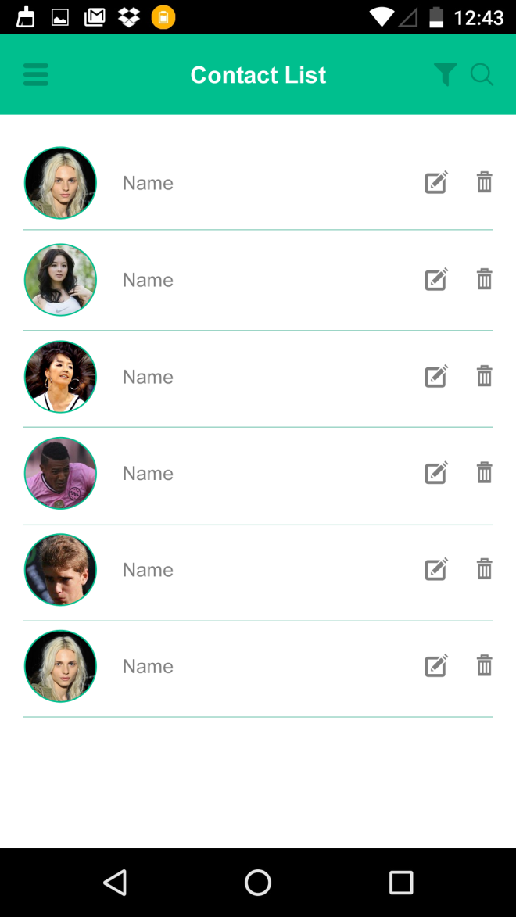
After successful save of contact from pervious screen user will be redirect to this screen.
By default all the contact will display from contact table.
User can delete/Edit the same.
Screen contains two more option
Search :- User can do search in incremental way.
Filter :- User can filter list by category.

Slide 4
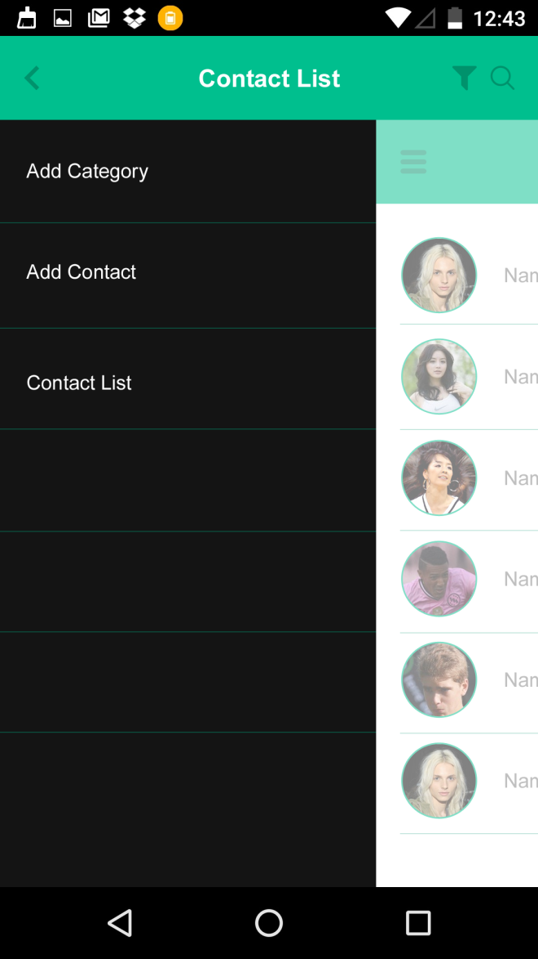
This is the menu screen for the
navigation of App.

